Slide 1
Test-Driven C♯
Rasmus Lystrøm
Associate Professor
ITU
rnie@itu.dk

Slide 2









M.Sc. IT, ITU (2012) Thesis: Forecalc – Developing a core spreadsheet implementation in F♯
1996-2008, 2013-: Captain @ Danish Army (Reserve) Acting Battalion Chief of Staff, Battalion Chief Operations Officer
2013-: Senior Consultant @ Microsoft DevOps, Cloud, Security
Hobbies
2014-: Associate Professor @ ITU Object-Oriented Programming, C♯, F♯, .NET Core
Wife: Katrine Children: Lærke (2), Laura (5), and Alma (12)
Origin: Aarhus Current whereabouts: Vanløse, Copenhagen

Slide 3
Agenda
Why C♯
Curriculum
Test-Driven Development
.NET (Core)
C♯
Visual Studio Code
Visual Studio 2019

Slide 4
Why C♯ - Popularity
Stack Overflow Annual Developer Survey 2020 – 65,000 respondents
https://insights.stackoverflow.com/survey/2020
C♯: 31.4%
ASP.NET: 21.9%
ASP.NET Core: 19.1%
.NET: 35.1%
.NET Core: 24.5%
Microsoft SQL Server: 33.0%
Bash/Shell/PowerShell: 33.1%
GitHub: 82.8% (top 1)
Visual Studio Code: 50.7% (top 1) (2019)
Visual Studio: 31.5% (top 2) (2019)

Slide 5
Why C♯ - Love
Stack Overflow Annual Developer Survey 2020 – 65,000 respondents
https://insights.stackoverflow.com/survey/2020
C♯: 59.7%
ASP.NET: 70.7% (top 1)
ASP.NET: 36.9%
.NET: 47.5%
.NET Core: 71.5% (top 1)
Microsoft SQL Server: 50.9%

Slide 6
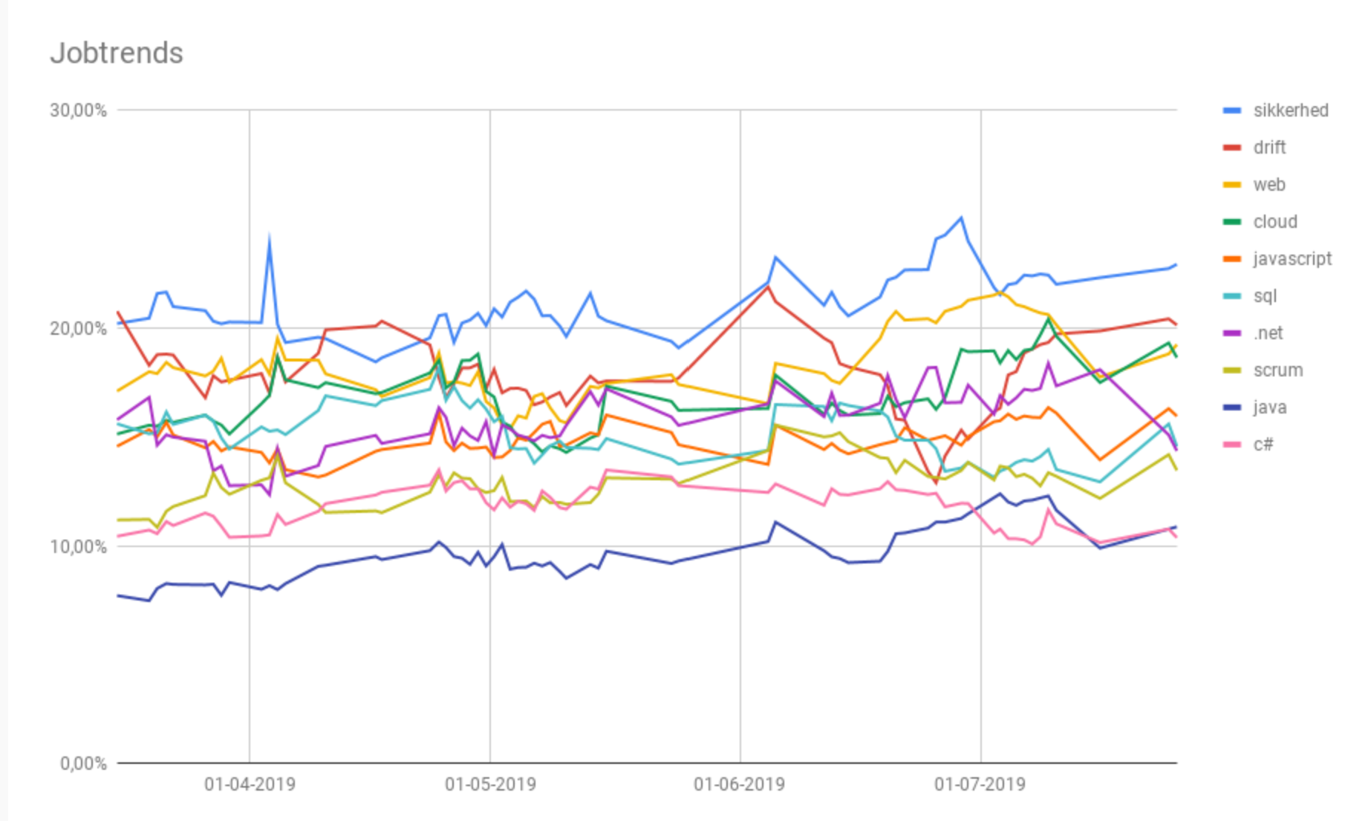
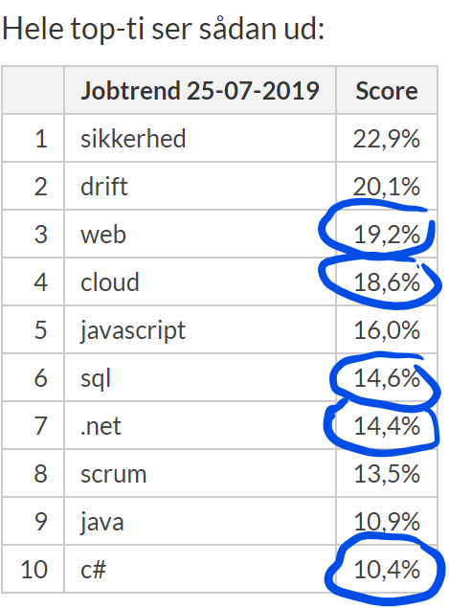
Job trends
Source: https://www.version2.dk/artikel/jobtrends-java-slaar-c-paa-maalfoto-1088564

Slide 7
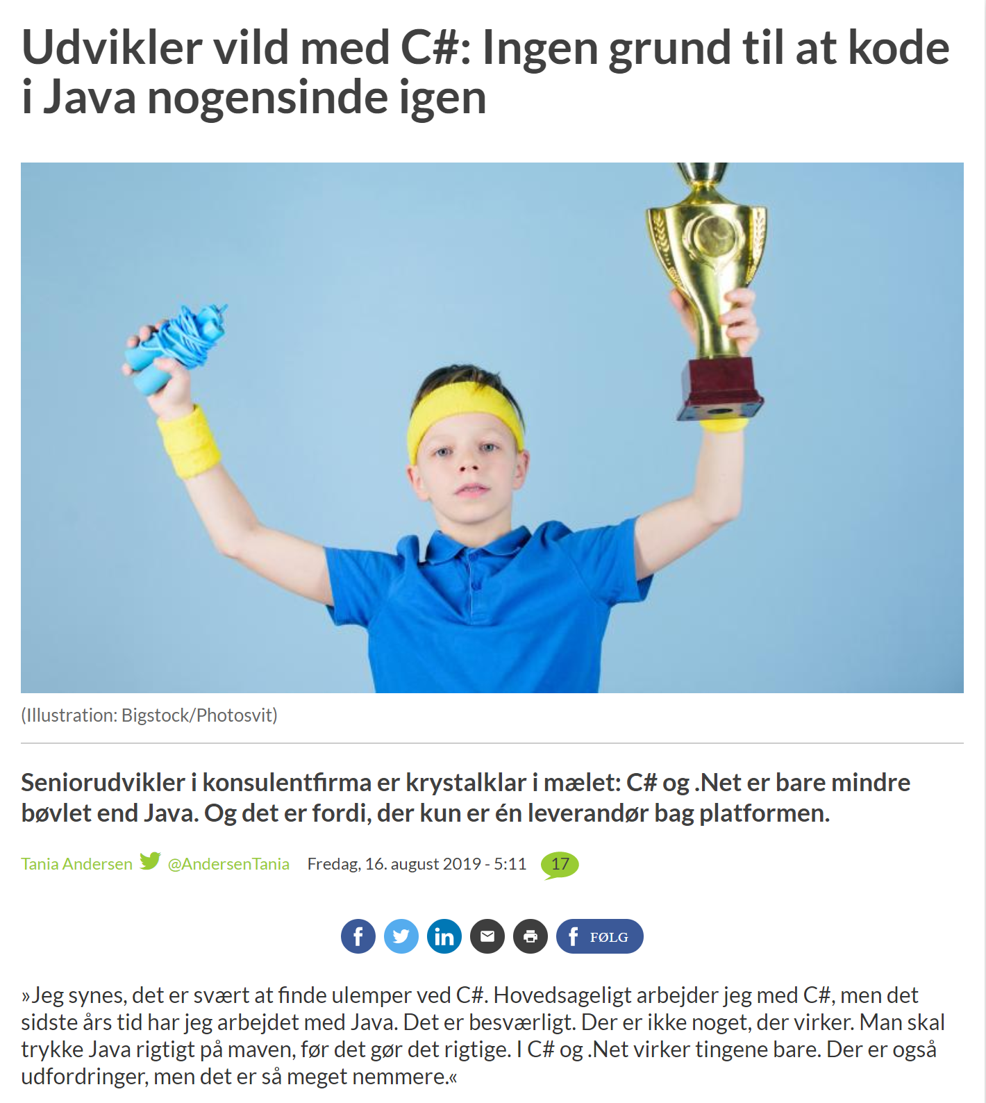
Source:
https://www.version2.dk/artikel/udvikler-vild-med-c-ingen-grund-at-kode-java-nogensinde-igen-1088651

Slide 8
Tentative Curriculum
Test-Driven C♯
Generics
Lambdas and Linq
Data access (SQL + Entity Framework)
Asynchronous and parallel processing
ASP.NET Core Web API
Design Patterns in Practice
Web apps with Blazor
Mobile apps with UWP and Xamarin.Forms
Security
Cloud

Slide 9
Test-Driven Development
What?
Why?
How?

Slide 10
Red – Green - Refactor
[Start]
Add a test
[No]
[Pass]
Run the tests
Done?
[Fail]
[Yes]
Refactor
[End]

Slide 11

A brief introduction

Slide 12
History of .NET and C#
 | .NET | .NET Core | C# | F# | Visual Studio | Visual Studio Code
2002 | 1.0 |  | 1.0 |  | .NET
2005 | 2.0 |  | 2.0 | 1.0 | 2005
2007 |  |  | 3.0
2008 | 3.5 |  |  |  | 2008
2010 | 4.0 |  | 4.0 | 2.0 | 2010
2012 | 4.5 |  |  | 3.0 | 2012
2013 | 4.5.1 |  | 5.0 | 3.1 | 2013
2015 | 4.6 |  | 6.0 | 4.0 | 2015
2016 |  | 1.0 |  |  |  | 1.0 – 1.8
2017 | 4.7 | 2.0 | 7.0 |  | 2017 | 1.9 – 1.19
2019 | 4.8 | 3.0 | 8.0 | 4.7 | 2019 | 1.20 – 130
2020 | 5.0 |  | 9.0 |  |  | 1.31 – 1.48…

Slide 13
C#
Show me the CODE!!!
C♯ is intended to be a simple, modern, general-purpose, object-oriented programming language.
Ecma International (2006)

Slide 14
Coding Kata

Slide 15
String Calculator Kata
Create a method with the following signature:
int Add(string numbers)
The method can take up to two numbers, separated by commas, and will return their sum.
for example “” or “1” or “1,2” as inputs.
(for an empty string it will return 0)
…
Source: https://osherove.com/tdd-kata-1

Slide 16
C# basics

Slide 17
Create a C# console app with a test library
mkdir MyApp
cd MyApp
dotnet new console -o MyApp
dotnet new xunit -o MyApp.Tests
dotnet new sln
dotnet sln add MyApp
dotnet sln add MyApp.Tests
dotnet add MyApp reference MyApp.Tests

Slide 18
Build, test, and run your app
dotnet build
dotnet test
dotnet run --project MyApp

Slide 19
Naming conventions
Composed names
currentLayout, CurrentLayout
Variables and fields
vehicle, leftElement
Private fields
_vehicle, _leftElement
Methods
CurrentVehicle(), Size()
Properties
Pi, Name, Size
Classes
MyClass, List<T>
Interfaces
IException, IObserver
https://docs.microsoft.com/en-us/dotnet/standard/design-guidelines/naming-guidelines

Slide 20
The C# class
using System;
namespace Namespace
{
public class Class
{
private string _field;
protected DateTime _inheritableField;
public string Property { get => _field; } // Getter
public int AutoProperty { get; set; }
public Class() // Constructor
{
}

Slide 21
The C# class (methods)
public object InstanceMethod(int parameter)
{
return null;
}
public virtual object OverridableInstanceMethod(bool parameter)
{
return null;
}
public static void StaticMethod()
{
}
private void PrivateInstanceMethod()
{
}

Slide 22
The C# class (events and delegates)
public event EventHandler Event;
protected virtual void OnEvent(EventArgs e)
{
EventHandler handler = Event;
handler?.Invoke(this, e);
}
}
public delegate void MyEventHandler(object sender, EventArgs e);
}

Slide 23
Built-in types
bool boolean; // true || false
char character; // 'a', 'b', 'c', '1', '2', '3'
// Floating point numeric types
decimal precisionFloatingPoint;
double floatingPoint64bit;
float floatingPoint32Bit;
// Integral numeric types
byte integer8bit; sbyte signedByte;
int integer32bit; uint unsignedInteger32bit;
long integer64bit; ulong unsignedInteger64bit;
short integer16bit; ushort unsignedInteger16bit;
// Reference types
object _object;
string _string;
dynamic dynamic;
https://docs.microsoft.com/en-us/dotnet/csharp/language-reference/builtin-types/built-in-types

Slide 24
Basic Unit Test
public class Ticker
{
public int Counter { get; private set; }
public void Increment() => Counter++;
}
public class TickerTests
{
[Fact]
public void Increment_when_called_increases_Counter_by_1()
{
// Arrange
var sut = new Ticker();
// Act
sut.Increment();
// Assert
Assert.Equal(1, sut.Counter);
}
}

